Slide 1


BANK LOAN ANALYSIS
MS SQL SERVER

Slide 2
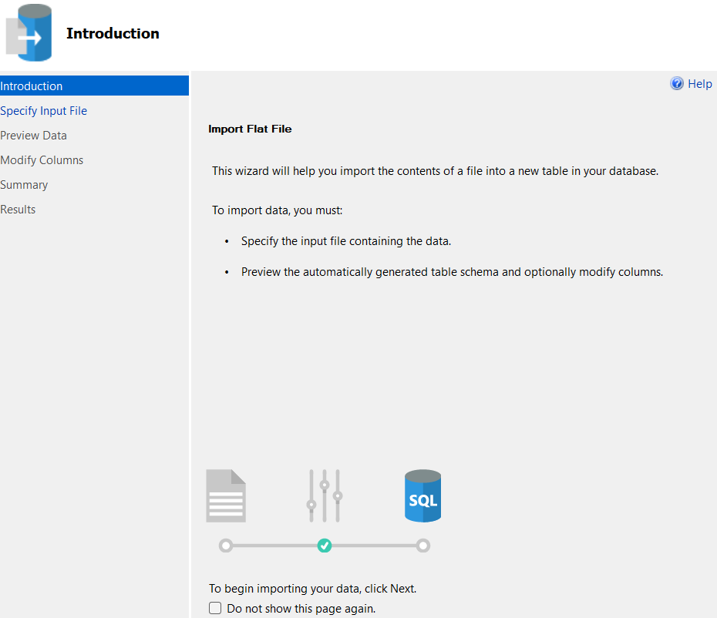

MS SQL SERVER
IMPORT
DATA

Slide 3

MS SQL SERVER
CREATING
DB

Slide 4
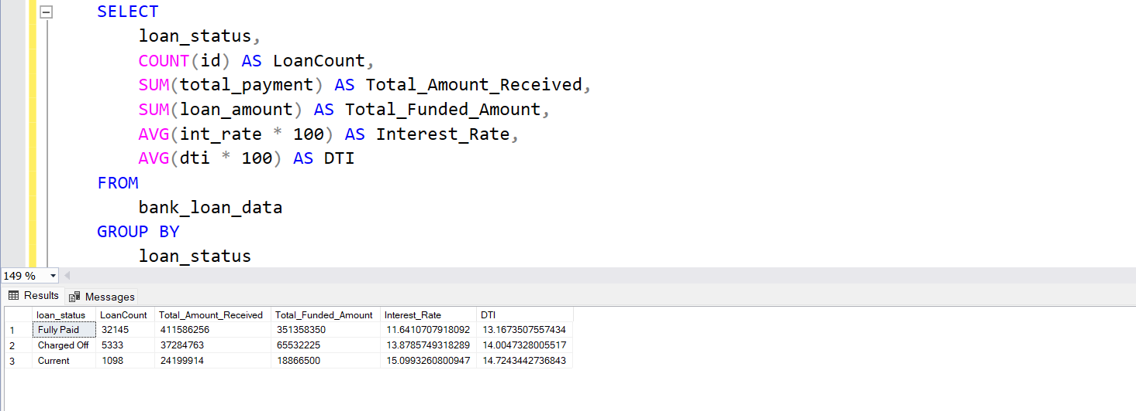
MS SQL SERVER
WRITING
QUERIES

